Slide 1
1215 St. Bernard Ave. Development Community Meeting
New Orleans, LA.
February 4th, 2021

Slide 2
WELCOME!

Slide 3
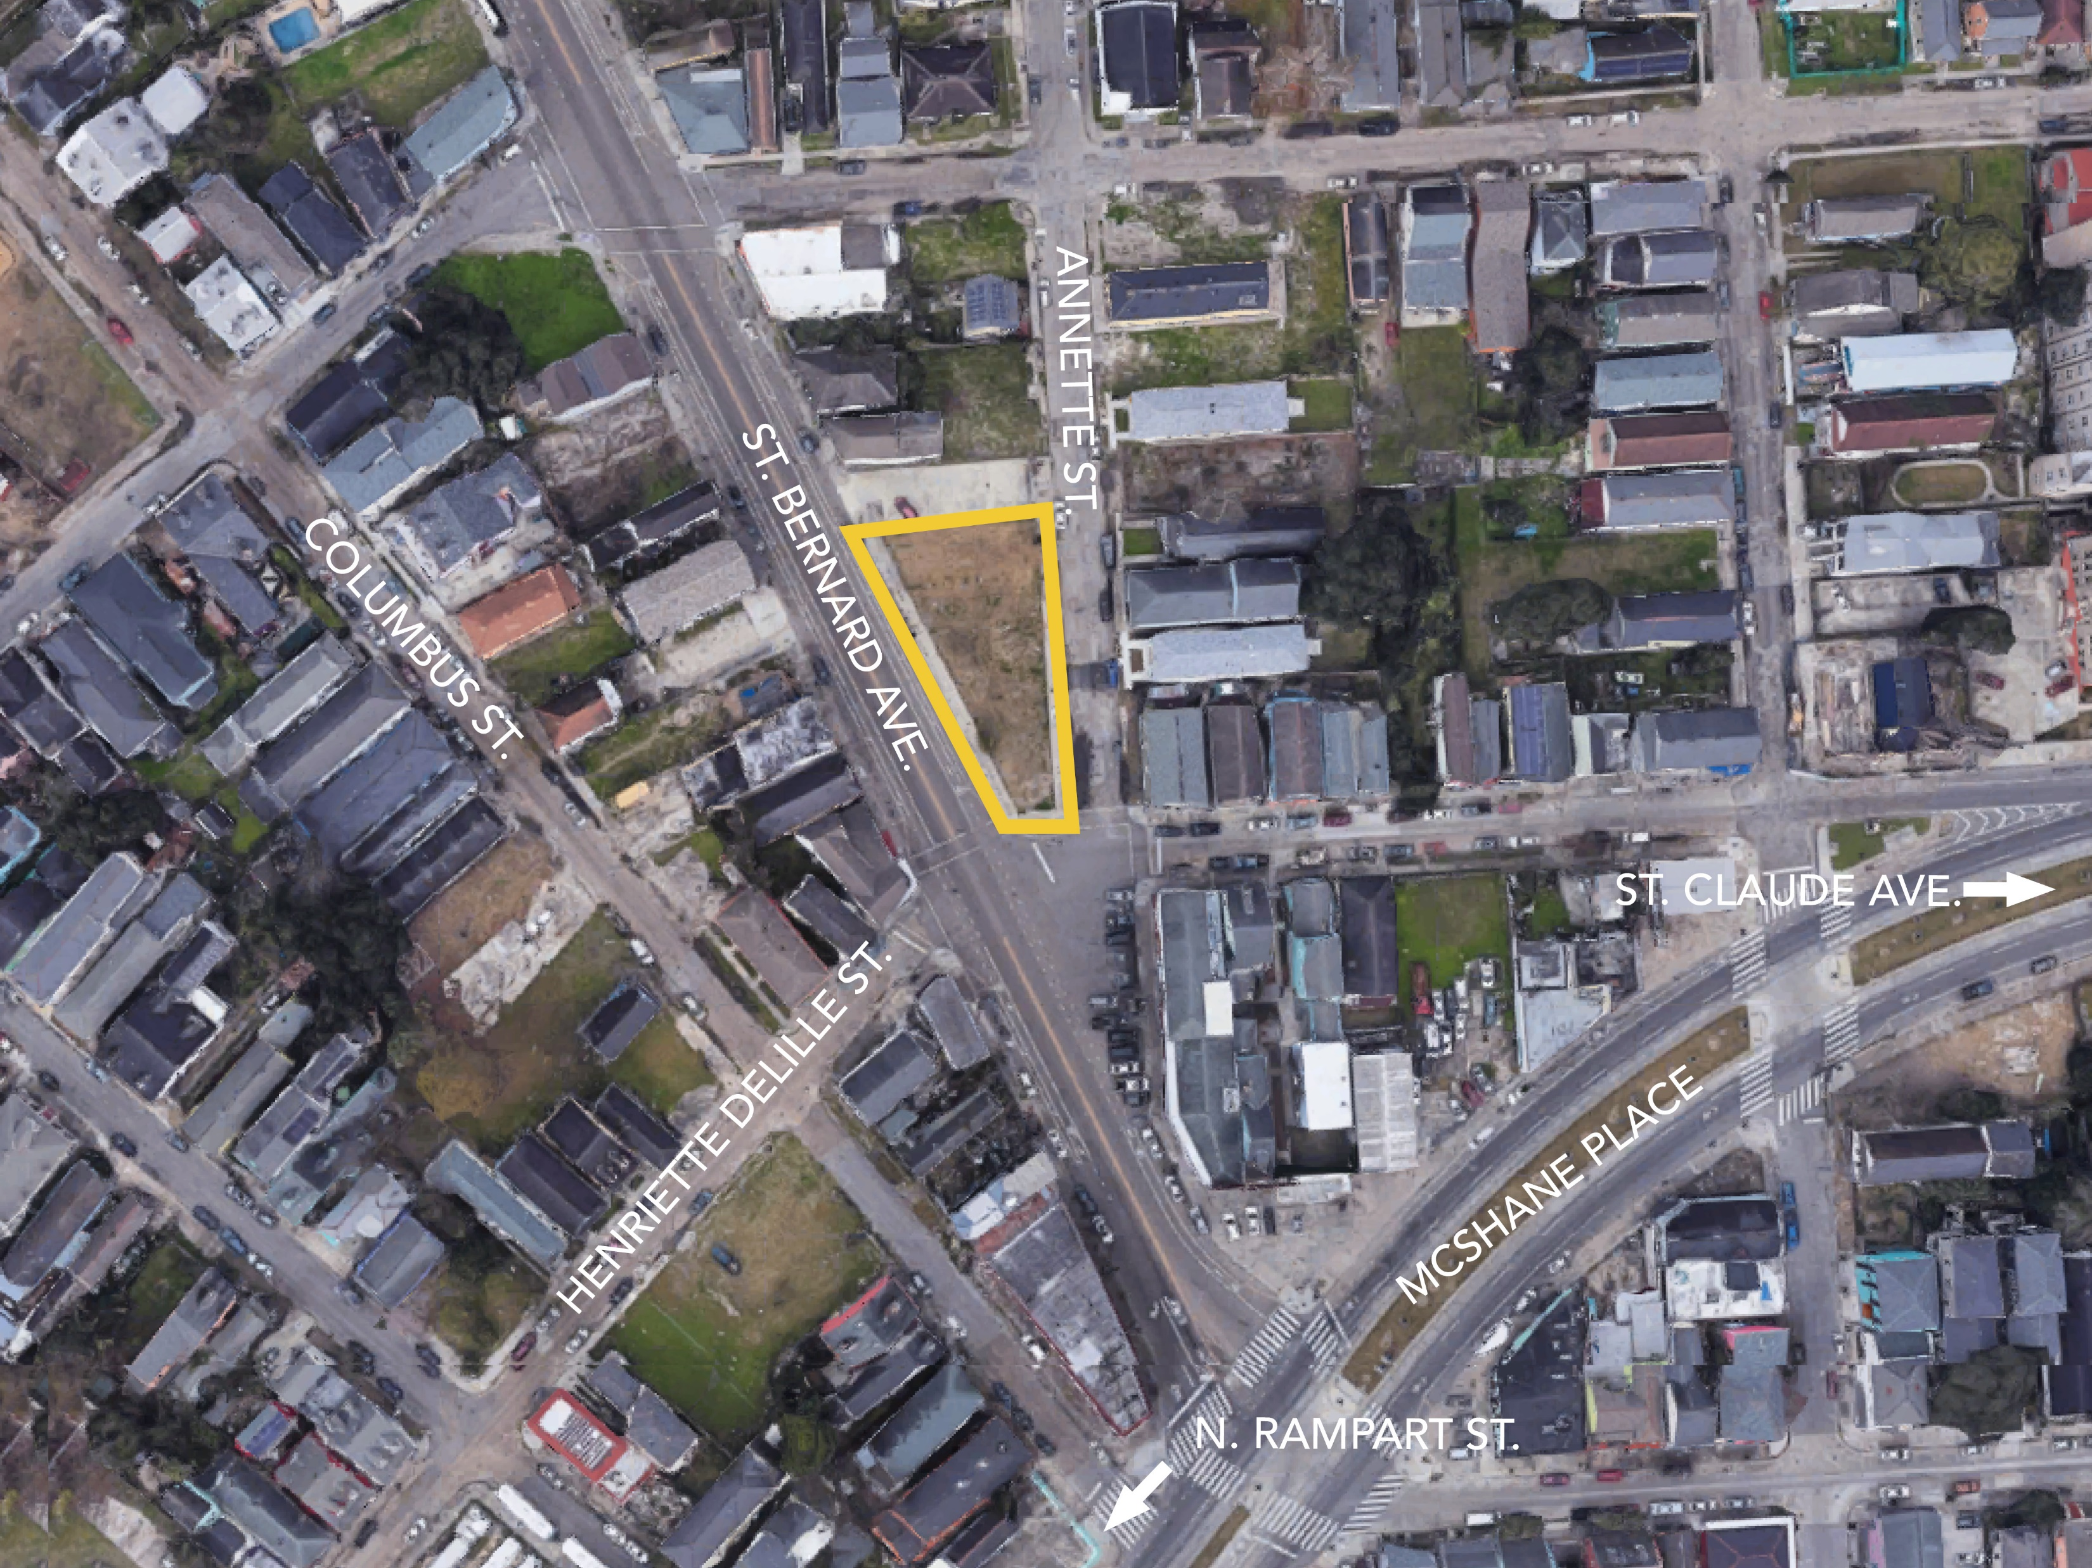

Slide 4
Our Team

Slide 5
Jalence Isles & Caitlin Kwan

Slide 6
George Silvertooth, Bobbie Hill, Melissa Lee, & Joel Ross

Slide 7
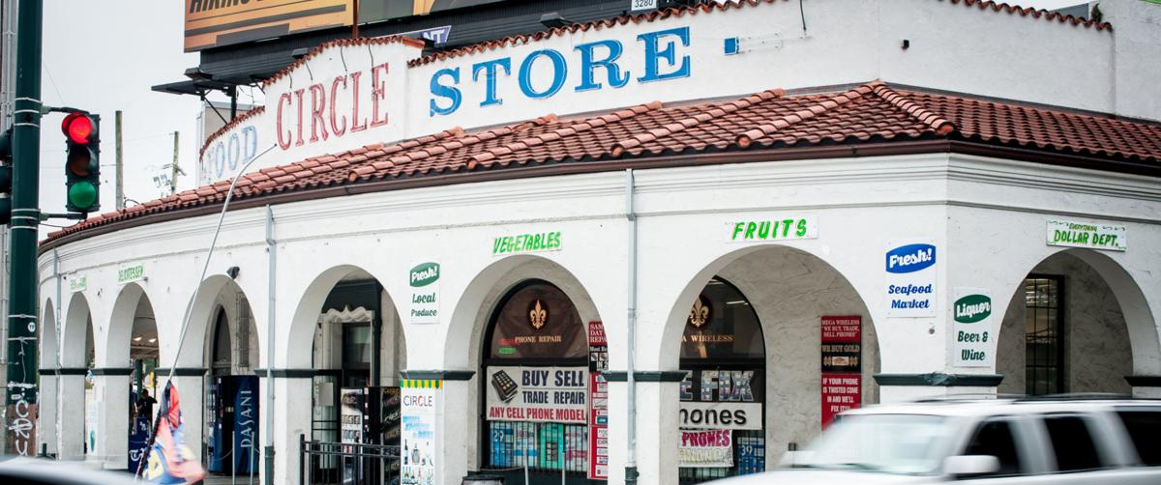
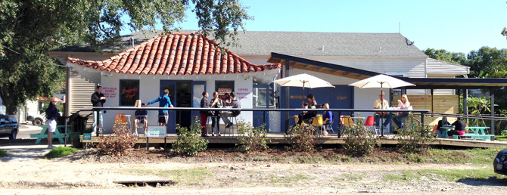
Our Commitments
Space that is accessible & attractive to the 7th ward community & visitors
Responsible Management

Slide 8
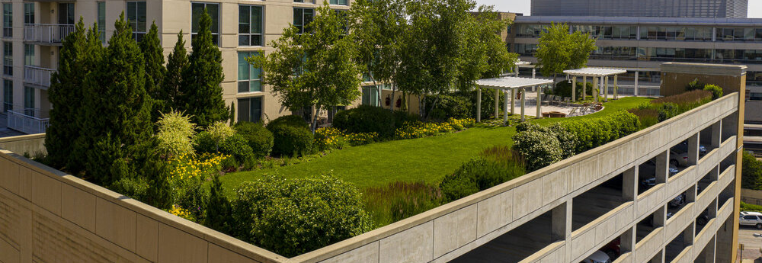
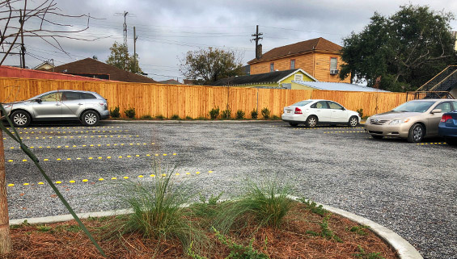
Our Commitments
Green Building Practices
Stormwater Management components, such as:
Green Roofs
Permeable Pavements
Bioswales

Slide 9
Today’s Goals
Meet the team.
Prioritize potential uses for the site.
Brainstorm what those uses could look like, who could help realize them, and how they can equitably benefit the neighborhood.

Slide 10
Timeline
Concept
Design
Shovels in the ground
Meeting 1
Meeting 2
February
March
April
Late 2021

Slide 11
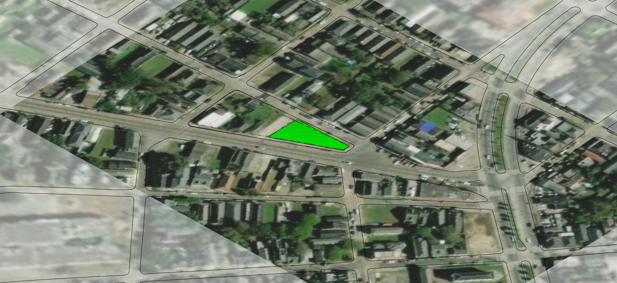
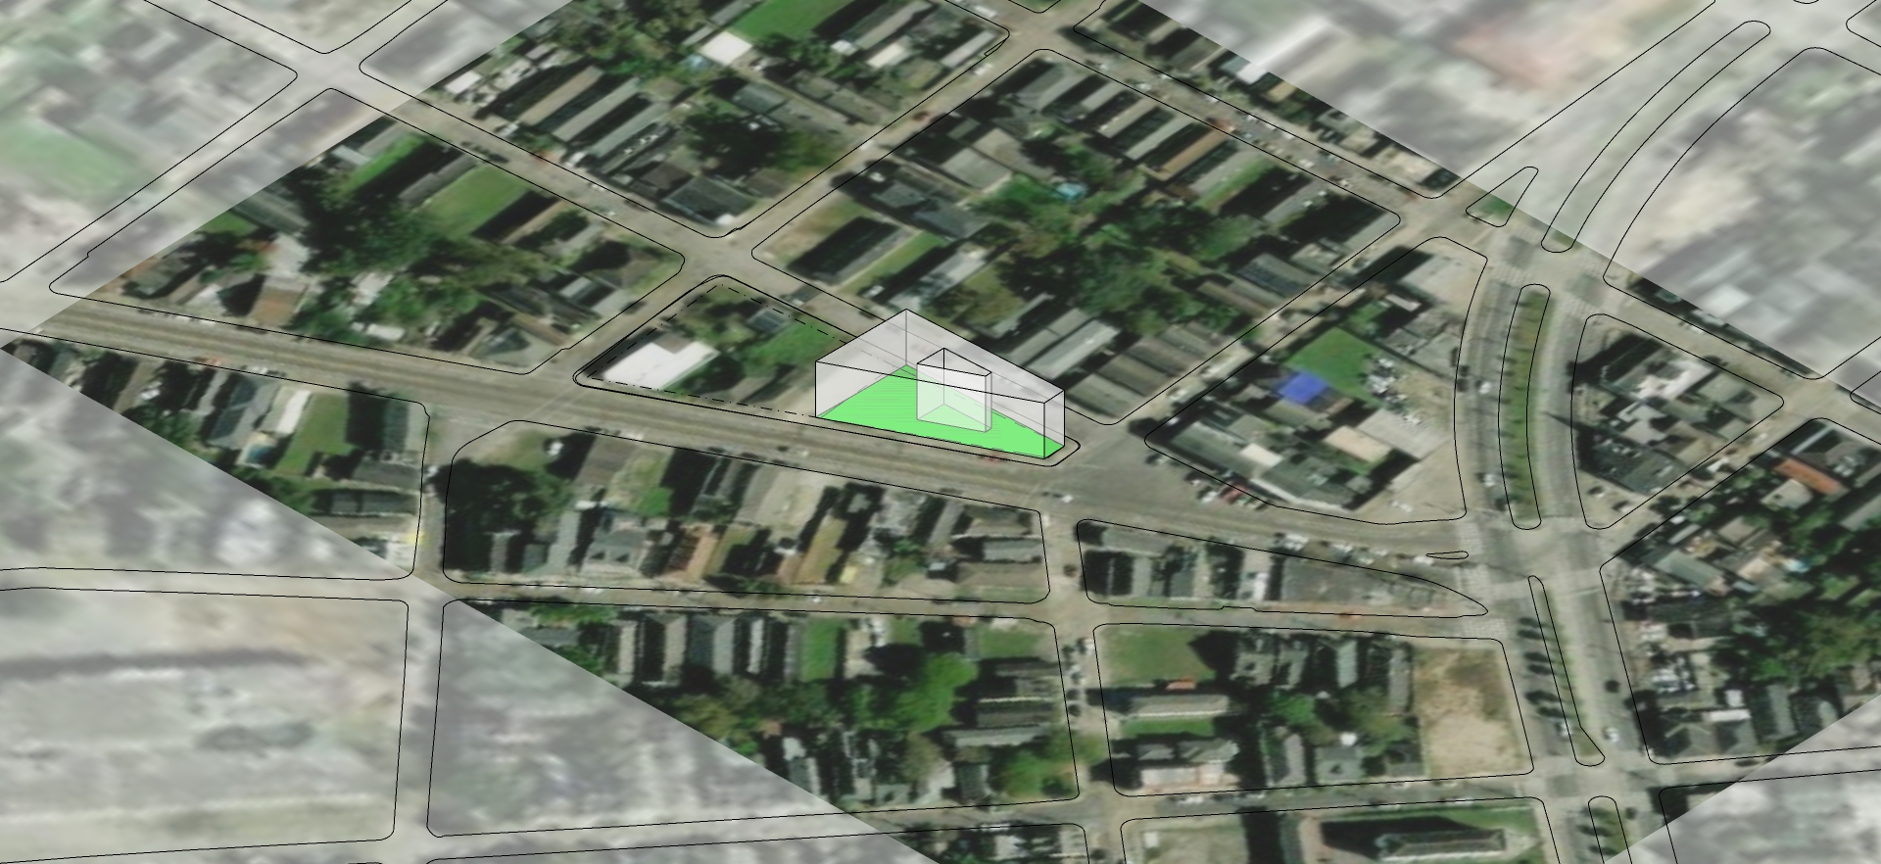
Zoning

Slide 12
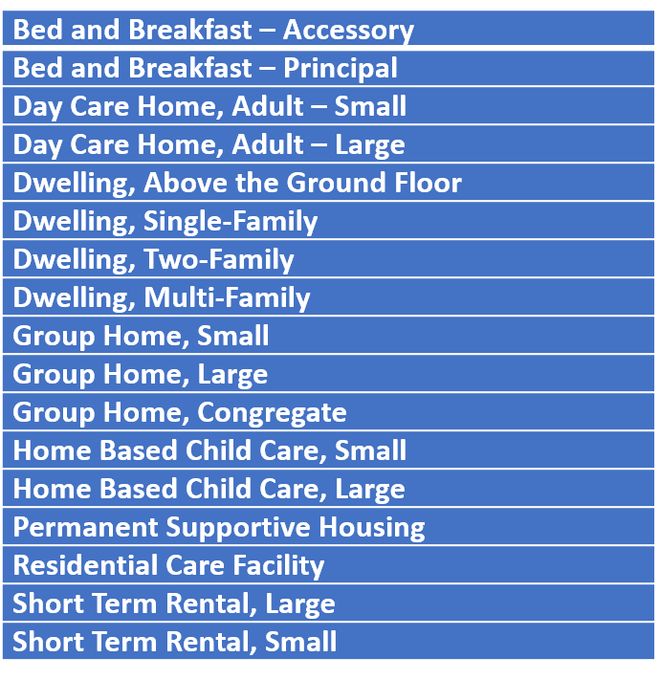
Permitted Uses

Slide 13
SO.
WHAT SHOULD WE DO?

Slide 14
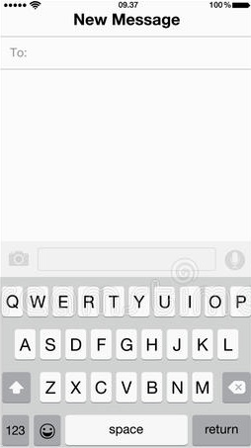
22333
LET’S SET UP OUR PHONES FOR POLLING QUESTIONS!
(YOU SHOULD RECEIVE A CONFIRMATION TEXT)
CONCORDIA477

Slide 15
LET’S GIVE IT A TRY:
Notes:
Poll Title: Is the glass half full or half empty? https://www.polleverywhere.com/multiple_choice_polls/Fu5jp4nebfslfr5CW1vLJ?flow=Default&onscreen=persist

Slide 16
Notes:
Poll Title: What is your zip code? https://www.polleverywhere.com/free_text_polls/Kp4vAjpZHltWc9pDCXe9Y

Slide 17
Notes:
Poll Title: How far from the site (1215 St. Bernard) do you live? https://www.polleverywhere.com/multiple_choice_polls/fdDzKPDjczurAWtXET0Ie

Slide 18
Notes:
Poll Title: How long have you lived in New Orleans? https://www.polleverywhere.com/multiple_choice_polls/8c3tA7fZCyI5zqHQjoCGi

Slide 19
Notes:
Poll Title: How do you normally celebrate Mardi Gras on St. Bernard? https://www.polleverywhere.com/free_text_polls/kgJTFm5N06JxyX7rpx05Q

Slide 20
Notes:
Poll Title: What should be the biggest priority for the development at St. Bernard? https://www.polleverywhere.com/multiple_choice_polls/7dL94KBFxV7ze9b7aCTJE

Slide 21
LET’S DIG DEEPER

Slide 22
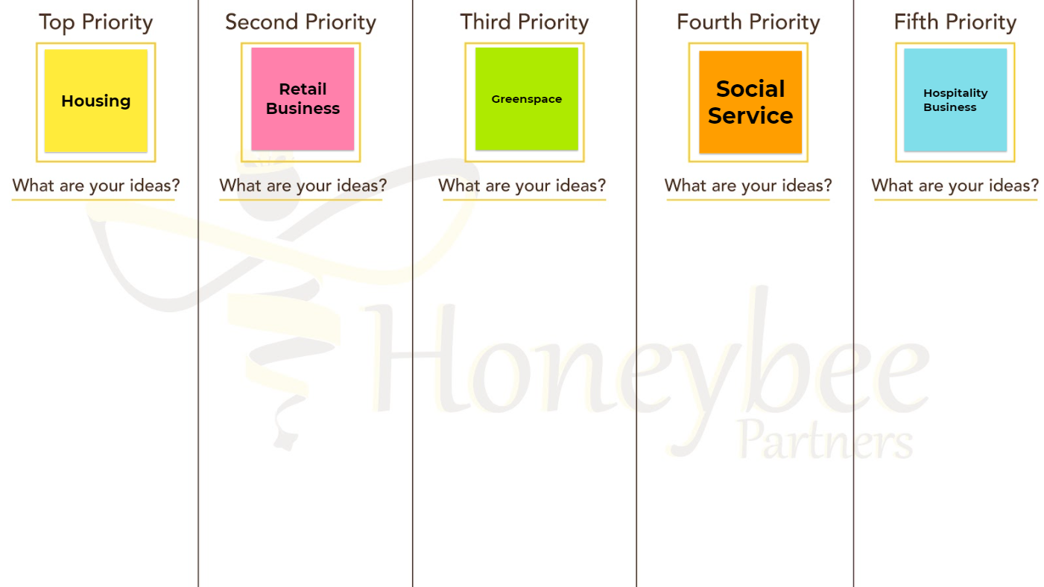
Breakout Rooms
The top five uses voted on by everyone, will be listed above.
With your group, brainstorm any ideas to expand on that use. Your room’s facilitator will help guide the conversation.

Slide 23
WHAT WERE SOME OF YOUR GROUP’S MAIN TAKEAWAYS?

Slide 24
AAR
Before you go…
Please fill out an
After Action Review!
Follow the link shared in the chat. It will help us create a better project and process.

Slide 25
THANK YOU FOR YOUR TIME AND IDEAS!
Contact Info:
jalence@honeybeepartners.com
caitlin@honeybeepartners.com
gsilvertooth@concordia.com

